Slide 1
Mathematics
Session 6: Special products
Haarlem
Peter Stikker
Notes:
Slides created by P. Stikker.
Version: 14 March 2019

Slide 2
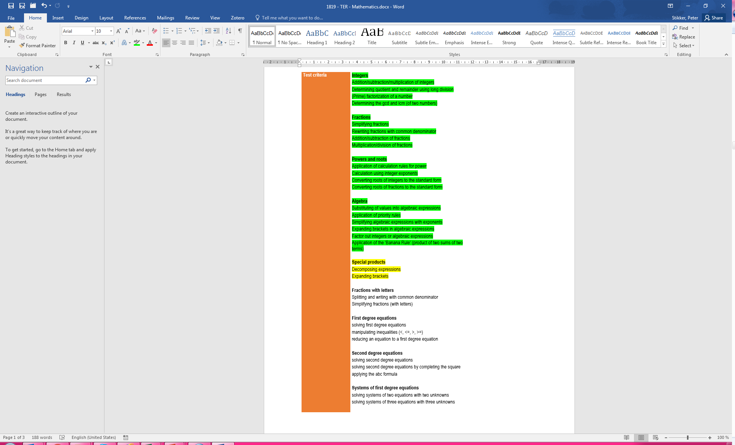
Today
The square of a sum
The square of a difference
The difference of two squares

Slide 3

Overview so far…
Fraction rules
Power rules
F1 | $$\frac{a}{b}=\frac{a×c}{b×c}=\frac{a/c}{b/c}$$
P1 | $$a^{p}×a^{q} =a^{p+q}$$
Notation rules
P2 | $$a^{p}:a^{q}=a^{p−q}$$
N1 | $$\frac{a}{b}=a/b=a:b$$
F2 | $$\frac{a}{b}+\frac{c}{b}=\frac{a+c}{b}$$
P3 | $${\left(a^{p}\right)}^{q} =a^{p×q}$$
N2 | $$a^{p}=a×a×…×a (p \text{times})$$
F3 | $$\frac{a}{b}−\frac{c}{b}=\frac{a−c}{b}$$
P4 | $${\left(a×b\right)}^{p}=a^{p}×b^{p}$$
N3 | $$a^{1}=a$$
P5 | $${\left(\frac{a}{b}\right)}^{p}=\frac{a^{p}}{b^{p}}$$
F4 | $$\frac{a}{b}×c=\frac{a×c}{b}$$
N4 | $$a×b=a∙b=ab$$
P6 | $$a^{−p}=\frac{1}{a^{p}}$$
N5 | $$\sqrt{a}=\sqrt[2]{a}$$
F5 | $$\frac{a}{b}×\frac{c}{d}=\frac{a×c}{b×d}$$
Root rules
Basic rules
F6 | $${\frac{a}{b}}/c=\frac{a}{b×c}$$
R1 | $$\sqrt{a^{2}}=a$$
R1 | $$\sqrt[n]{a^{n}}=a$$
B1 | $$\frac{a}{1}=a$$
R2 | $${\left(\sqrt[n]{a}\right)}^{n}=a$$
F7 | $${\frac{a}{b}}/{\frac{c}{d}}=\frac{a×d}{b×c}$$
R2 | $${\left(\sqrt{a}\right)}^{2}=a$$
B2 | $$\frac{a}{a}=1$$
R3 | $$\sqrt[n]{a}×\sqrt[n]{b}=\sqrt[n]{a×b}$$
R3 | $$\sqrt{a}×\sqrt{b}=\sqrt{a×b}$$
Brackets rules
R4 | $$\frac{a}{\sqrt{b}}=\frac{a}{b}\sqrt{b}$$
B3 | $$a×1=a$$
B4 | $$a×b=b×a$$
Br1 | $$a\left(b+c\right)=ab+ac$$
R5 | $$\sqrt{\frac{a}{b}}=\frac{1}{b}\sqrt{a×b}$$
B5 | $$a+b=b+a$$
Br2 | $$\left(a+b\right)\left(c+d\right)=ac+ad+bc+bd$$

Slide 4
Segment 1: The square of a sum
Avoiding the banana formula for a square of a sum

Slide 5
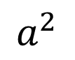
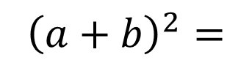
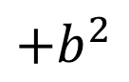
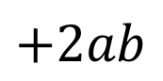
Special product 1
square
square
$${\left(a+b\right)}^{2}=$$
$$a^{2}$$
$$+2ab$$
$$+b^{2}$$
2 times the two terms

Slide 6


Visual
a
ab
a²
b
b²
ab
b
a
$${\left(a+b\right)}^{2}=a^{2}+2ab+b^{2}$$
Br3 | $${\left(a+b\right)}^{2}=a^{2}+2ab+b^{2}$$

Slide 7
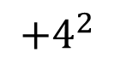
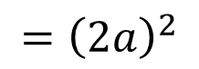
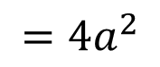
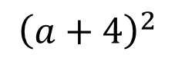
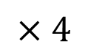
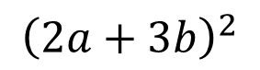
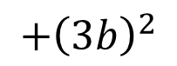

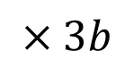
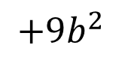
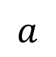
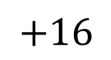
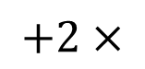
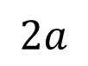
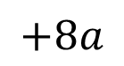
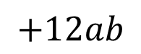
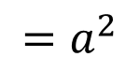
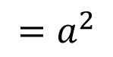
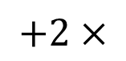
Two Examples
Br3 | $${\left(a+b\right)}^{2}=a^{2}+2ab+b^{2}$$
$${\left(a+4\right)}^{2}$$
$$=a^{2}$$
$$+2×$$
$$a$$
$$×4$$
$$+4^{2}$$
$$=a^{2}$$
$$+8a$$
$$+16$$
$${\left(2a+3b\right)}^{2}$$
$$={\left(2a\right)}^{2}$$
$$+2×$$
$$2a$$
$$×3b$$
$$+{\left(3b\right)}^{2}$$
$$=4a^{2}$$
$$+12ab$$
$$+9b^{2}$$

Slide 8
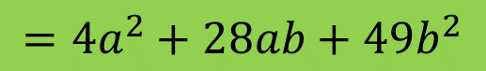



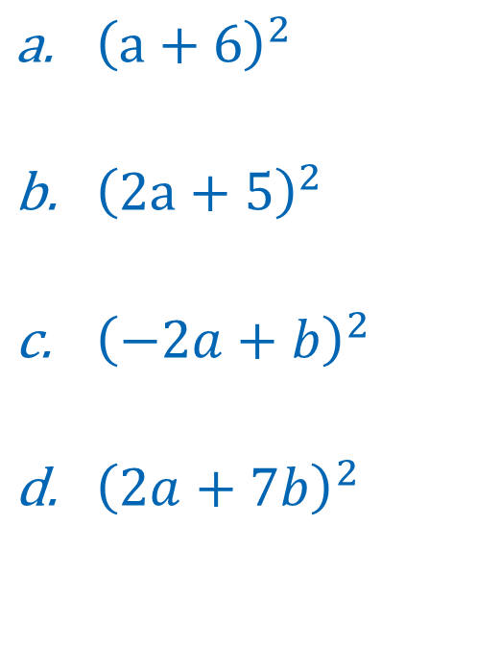

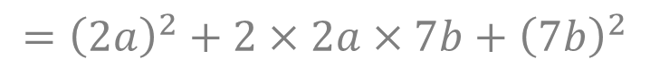



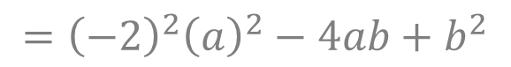
Practice 1
${\left(a+6\right)}^{2}$
${\left(2a+5\right)}^{2}$
${\left(−2a+b\right)}^{2}$
${\left(2a+7b\right)}^{2}$
$$=a^{2}+2×a×6+6^{2}$$
$$=a^{2}+12a+36$$
$$={\left(2a\right)}^{2}+2×2a×5+5^{2}$$
$$={\left(2\right)}^{2}{\left(a\right)}^{2}+20a+25$$
$$=4a^{2}+20a+25$$
$$={\left(−2a\right)}^{2}+2×\left(−2\right)a×b+b^{2}$$
$$={\left(−2\right)}^{2}{\left(a\right)}^{2}−4ab+b^{2}$$
$$=4a^{2}−4ab+b^{2}$$
$$={\left(2a\right)}^{2}+2×2a×7b+{\left(7b\right)}^{2}$$
$$={\left(2\right)}^{2}{\left(a\right)}^{2}+28ab+{\left(7\right)}^{2}{\left(b\right)}^{2}$$
$$=4a^{2}+28ab+49b^{2}$$

Slide 9
Segment 2: The square of a difference
Avoiding the banana formula for a square of a difference

Slide 10

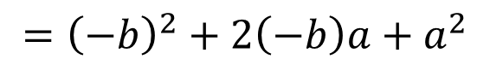
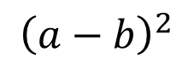
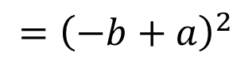
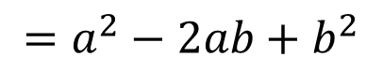

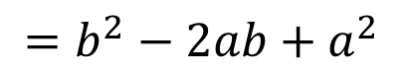

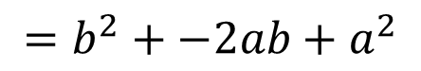

Square of a difference
$${\left(a−b\right)}^{2}$$
B5 | $$a+b=b+a$$
$$={\left(−b+a\right)}^{2}$$
Br3 | $${\left(a+b\right)}^{2}=a^{2}+2ab+b^{2}$$
$$={\left(−b\right)}^{2}+2\left(−b\right)a+a^{2}$$
$$=b^{2}+−2ab+a^{2}$$
$$=b^{2}−2ab+a^{2}$$
B5 | $$a+b=b+a$$
$$=a^{2}−2ab+b^{2}$$
Br4 | $${\left(a−b\right)}^{2}=a^{2}−2ab+b^{2}$$

Slide 11
Visual
Large square of a by a.
Area of large square: a x a = a².
a - b
b(a – b)
(a – b)²
Remove a square of b by b.
Area blue square: b x b = b².
a
The remaining length is a - b.
This gives the following rectangles.
b
b²
b(a – b)
The area of the large square, minus the red and blue one, should equal the area of the yellow
b
a - b
a
a² – b(a – b) – b(a – b) – b²
= a² – ab + b² – ab + b² – b²
= a² – 2ab + b²
(a – b)²
= a² – 2ab + b²

Slide 12
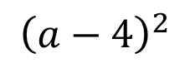
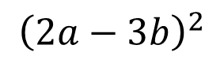

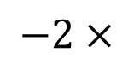
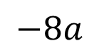
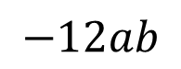
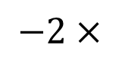
Two Examples
Br4 | $${\left(a−b\right)}^{2}=a^{2}−2ab+b^{2}$$
$${\left(a−4\right)}^{2}$$
$$=a^{2}$$
$$−2×$$
$$a$$
$$×4$$
$$+4^{2}$$
$$=a^{2}$$
$$−8a$$
$$+16$$
$${\left(2a−3b\right)}^{2}$$
$$={\left(2a\right)}^{2}$$
$$−2×$$
$$2a$$
$$×3b$$
$$+{\left(3b\right)}^{2}$$
$$=4a^{2}$$
$$−12ab$$
$$+9b^{2}$$

Slide 13
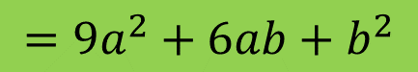


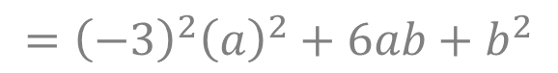
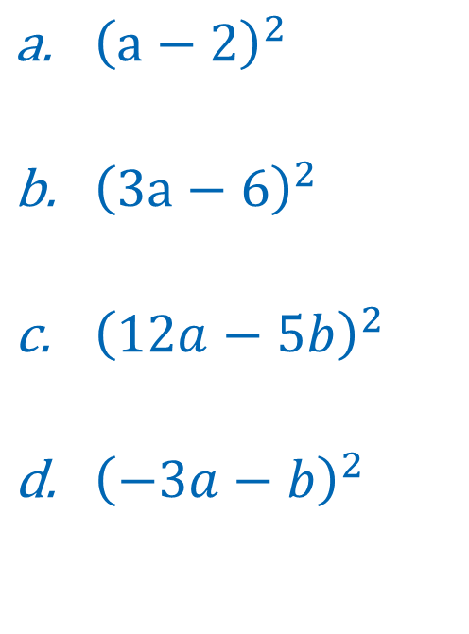


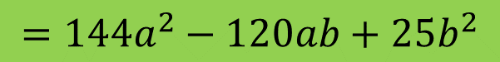
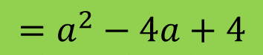
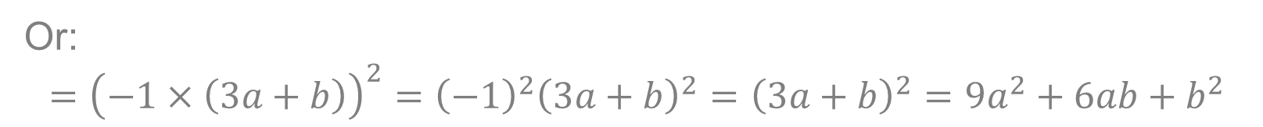
Practice 2
${\left(a−2\right)}^{2}$
${\left(3a−6\right)}^{2}$
${\left(12a−5b\right)}^{2}$
${\left(−3a−b\right)}^{2}$
$$=a^{2}−2×a×2+2^{2}$$
$$=a^{2}−4a+4$$
$$={\left(3a\right)}^{2}−2×3a×6+6^{2}$$
$$={\left(3\right)}^{2}{\left(a\right)}^{2}−36a+36$$
$$=9a^{2}−36a+36$$
$$={\left(12a\right)}^{2}−2×12a×5b+{\left(5b\right)}^{2}$$
$$={\left(12\right)}^{2}{\left(a\right)}^{2}−120ab+{\left(5\right)}^{2}{\left(b\right)}^{2}$$
$$=144a^{2}−120ab+25b^{2}$$
$$={\left(−3a\right)}^{2}−2×\left(−3\right)a×b+{\left(b\right)}^{2}$$
$$={\left(−3\right)}^{2}{\left(a\right)}^{2}+6ab+b^{2}$$
$$=9a^{2}+6ab+b^{2}$$
Or: $$={\left(−1×\left(3a+b\right)\right)}^{2}={\left(−1\right)}^{2}{\left(3a+b\right)}^{2}={\left(3a+b\right)}^{2}=9a^{2}+6ab+b^{2}$$

Slide 14
Segment 3: Difference of two squares
Avoiding the banana formula by recognizing the factorization of the difference of two squares
Decompose expression by recognizing the difference of two squares

Slide 15
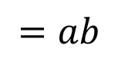

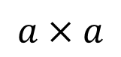
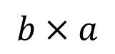
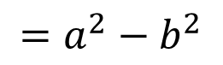
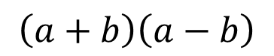






Square of a difference
$$\left(a+b\right)\left(a−b\right)$$
$$a×a$$
$$=a^{2}$$
$$a×\left(−b\right)$$
$$=−ab$$
$$b×a$$
$$=ab$$
$$b×\left(−b\right)$$
$$=−b^{2}$$
$$=a^{2}+−ab+ab+−b^{2}$$
$$=a^{2}−b^{2}$$
Br5 | $$\left(a+b\right)\left(a−b\right)=a^{2}−b^{2}$$

Slide 16













Examples: Removing brackets
Br5 | $$\left(a+b\right)\left(a−b\right)=a^{2}−b^{2}$$
$$\left(a+2b\right)\left(a−2b\right)$$
$$=a^{2}−{\left(2b\right)}^{2}$$
$$=a^{2}−{\left(2\right)}^{2}{\left(b\right)}^{2}$$
$$=a^{2}−4b^{2}$$
$$\left(3a+5\right)\left(3a−5\right)$$
$$={\left(3a\right)}^{2}−5^{2}$$
$$={\left(3\right)}^{2}{\left(a\right)}^{2}−25$$
$$=9a^{2}−25$$
$$\left(a^{3}−b^{3}\right)\left(a^{3}+b^{3}\right)$$
$$={\left(a^{3}\right)}^{2}−{\left(b^{3}\right)}^{2}$$
$$=a^{3×2}−b^{3×2}$$
$$=a^{6}−b^{6}$$

Slide 17

















Examples: decomposing
Br5 | $$\left(a+b\right)\left(a−b\right)=a^{2}−b^{2}$$
$$a^{2}−25$$
$$=a^{2}−5^{2}$$
$$=\left(a+5\right)\left(a−5\right)$$
$$4a^{2}b^{2}−1$$
$$=2^{2}a^{2}b^{2}−1^{2}$$
$$={\left(2ab\right)}^{2}−1^{2}$$
$$=\left(2ab+1\right)\left(2ab−1\right)$$
P4 | $${\left(a×b\right)}^{p}=a^{p}×b^{p}$$
P4 | $${\left(a×b\right)}^{p}=a^{p}×b^{p}$$
$$a^{6}−9b^{6}$$
$$=a^{6}−3^{2}b^{6}$$
$$=a^{3×2}−3^{2}b^{3×2}$$
$$={\left(a^{3}\right)}^{2}−3^{2}{\left(b^{3}\right)}^{2}$$
$$={\left(a^{3}\right)}^{2}−{\left(3b^{3}\right)}^{2}$$
P3 | $${\left(a^{p}\right)}^{q} =a^{p×q}$$
$$=\left(a^{3}+3b^{3}\right)\left(a^{3}−3b^{3}\right)$$

Slide 18
























Practice 3
Decompose the following expressions :
a. $a^{2}−16$
b. $a^{2}−1$ c. $4a^{2}−9$ d. $9a^{2}−1$
$$={\left(a^{2}\right)}^{2}−b^{2}$$
$$=a^{2}−4^{2}$$
e. $a^{4}−b^{2}$ f. $25a^{4}−16b^{2}$ g. $a^{3}−a$
h. ${8a}^{2}−50$
$$=\left(a+4\right)\left(a−4\right)$$
$$=\left(a^{2}+b\right)\left(a^{2}−b\right)$$
$$=a^{2}−1^{2}$$
$$=5^{2}{\left(a^{2}\right)}^{2}−4^{2}b^{2}$$
$$=\left(a+1\right)\left(a−1\right)$$
$$={\left(5a^{2}\right)}^{2}−{\left(4b\right)}^{2}$$
$$=\left(5a^{2}+4b\right)\left(5a^{2}−4b\right)$$
$$=2^{2}a^{2}−3^{2}$$
$$={\left(2a\right)}^{2}−3^{2}$$
$$=a\left(a^{2}−1\right)$$
$$=a\left(a^{2}−1^{2}\right)$$
$$=\left(2a+3\right)\left(2a−3\right)$$
$$=a\left(a+1\right)\left(a−1\right)$$
$$=3^{2}a^{2}−1^{2}$$
$$={\left(3a\right)}^{2}−1^{2}$$
$$=2\left(4a^{2}−25\right)$$
$$=2\left(2^{2}a^{2}−5^{2}\right)$$
$$=\left(3a+1\right)\left(3a−1\right)$$
$$=2\left({\left(2a\right)}^{2}−5^{2}\right)$$
$$=2\left(2a+5\right)\left(2a−5\right)$$

Slide 19
Closure
Overview & H☺mew☹rk

Slide 20




































Overview so far…
Power rules
Fraction rules
Notation rules
P1 | $$a^{p}×a^{q} =a^{p+q}$$
F1 | $$\frac{a}{b}=\frac{a×c}{b×c}=\frac{a/c}{b/c}$$
F5 | $$\frac{a}{b}×\frac{c}{d}=\frac{a×c}{b×d}$$
N1 | $$\frac{a}{b}=a/b=a:b$$
P2 | $$a^{p}:a^{q}=a^{p−q}$$
F2 | $$\frac{a}{b}+\frac{c}{b}=\frac{a+c}{b}$$
F6 | $${\frac{a}{b}}/c=\frac{a}{b×c}$$
N2 | $$a^{p}=a×a×…×a \\ (p \text{times})$$
P3 | $${\left(a^{p}\right)}^{q} =a^{p×q}$$
P4 | $${\left(a×b\right)}^{p}=a^{p}×b^{p}$$
F3 | $$\frac{a}{b}−\frac{c}{b}=\frac{a−c}{b}$$
F7 | $${\frac{a}{b}}/{\frac{c}{d}}=\frac{a×d}{b×c}$$
N3 | $$a^{1}=a$$
P5 | $${\left(\frac{a}{b}\right)}^{p}=\frac{a^{p}}{b^{p}}$$
N4 | $$a×b=a∙b=ab$$
F4 | $$\frac{a}{b}×c=\frac{a×c}{b}$$
N5 | $$\sqrt{a}=\sqrt[2]{a}$$
P6 | $$a^{−p}=\frac{1}{a^{p}}$$
Basic rules
Root rules
Brackets rules
B1 | $$\frac{a}{1}=a$$
R1 | $$\sqrt{a^{2}}=a$$
R1 | $$\sqrt[n]{a^{n}}=a$$
Br1 | $$a\left(b+c\right)=ab+ac$$
R2 | $${\left(\sqrt[n]{a}\right)}^{n}=a$$
B2 | $$\frac{a}{a}=1$$
R2 | $${\left(\sqrt{a}\right)}^{2}=a$$
Br2 | $$\left(a+b\right)\left(c+d\right)=ac+ad+bc+bd$$
R3 | $$\sqrt[n]{a}×\sqrt[n]{b}=\sqrt[n]{a×b}$$
R3 | $$\sqrt{a}×\sqrt{b}=\sqrt{a×b}$$
Br3 | $${\left(a+b\right)}^{2}=a^{2}+2ab+b^{2}$$
B3 | $$a×1=a$$
R4 | $$\frac{a}{\sqrt{b}}=\frac{a}{b}\sqrt{b}$$
Br4 | $${\left(a−b\right)}^{2}=a^{2}−2ab+b^{2}$$
B4 | $$a×b=b×a$$
B5 | $$a+b=b+a$$
R5 | $$\sqrt{\frac{a}{b}}=\frac{1}{b}\sqrt{a×b}$$
Br5 | $$\left(a+b\right)\left(a−b\right)=a^{2}−b^{2}$$

Slide 21

H☺me W☹rk
Theory: Chapter 5, pages 40-45
Selected exercises: pg. 40) 5.1 5.4 5.6 5.8 5.9 5.10
pg. 42) 5.13 5.15 5.17 5.18 5.20 5.21
pg. 44) 5.35 5.36
pg. 45) 5.37 5.38 5.39 5.40

